Slide 1

Modeling Maternal Mortality Rates (MMR)
https://assets.weforum.org/article/image/large_b05pCeiWDULOlBGVxJ52gFYvy6EPYx8R5WyOhPz1lNQ.jpg
Data Science Part Time Course
Rebecca Minich
11.29.16
Notes:
https://assets.weforum.org/article/image/large_b05pCeiWDULOlBGVxJ52gFYvy6EPYx8R5WyOhPz1lNQ.jpg

Slide 2
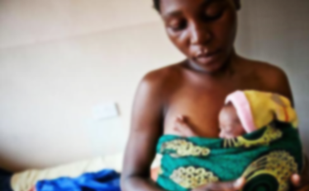
What factors contribute to global MMR?
PROBLEM STATEMENT:
Can I predict which socioeconomic and public health initiatives will improve global maternal mortality rates?
http://healthreportereastafrica.com/wpontent/uploads/2016/01/premature-babies-ug.jpg
Notes:
Numerous sociopolitical factors contribute, you can see this at play with the individual states in the US. In regions with high MMRs,

Slide 3
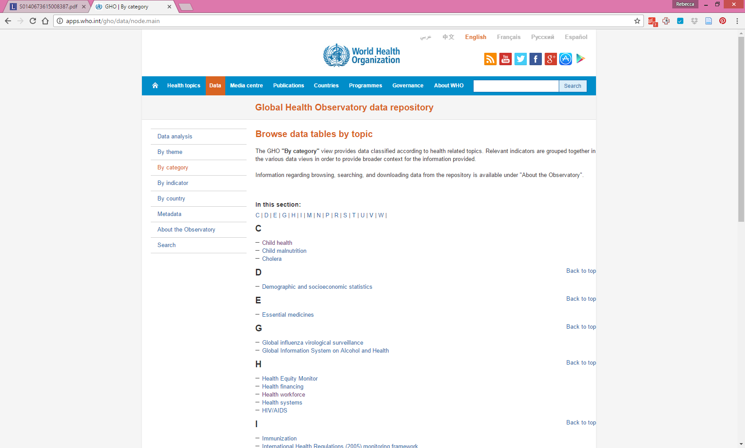

Could other factors contribute to MMR?
Datasets
Maternal Mortality Rates (MMR):
Birth attendant
Antenatal (prenatal) care
Adolescent Birth Rates
Contraceptives modern methods
Abortion policy scale
Education: Primary School Enrollment
Technology: Cellphone Subscribers
War: Homicides
Health: Life Expectancy
Wealth: GNI Per Capita Data by Country(PPP)
Notes:
Main data sources for HDI data - Column 1: HDRO calculations based on data from UNDESA (2015), UNESCO Institute for Statistics (2015), United Nations Statistics Division (2015), World Bank (2015a), Barro and Lee (2014) and IMF (2015). Column 2: UNDESA (2015). Column 3: UNESCO Institute for Statistics (2015). Column 4: UNESCO Institute for Statistics (2015), Barro and Lee (2014), UNICEF Multiple Indicator Cluster Surveys and ICF Macro Demographic and Health Surveys. Column 5: World Bank (2015a), IMF (2015) and United Nations Statistics Division (2015). Column 6: Calculated based on data in columns 1 and 5.

Slide 4
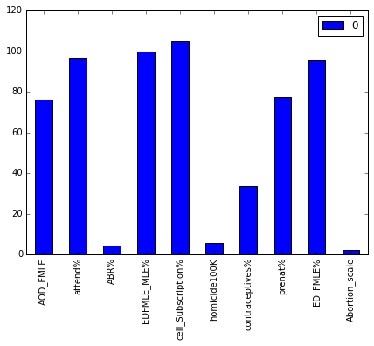
Dataframe and Feature Engineering
190 countries
12 different datasets, 33 total columns
Missing data filled with median values:

Slide 5
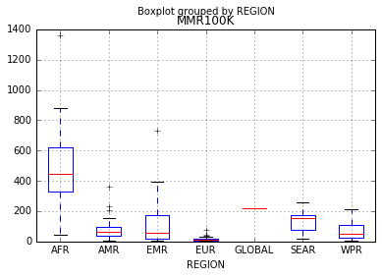
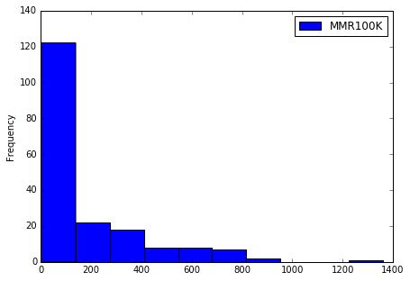
Response Variable Engineering
Regional MMR
MMR Frequency
MMR100K - Maternal deaths per 100,000 births
MMRClassifier - Created for logistic regression model based on min, max and 25, 50, 75% of MMR.
MMRBinary - Binary variable for logistic regression model.

Slide 6
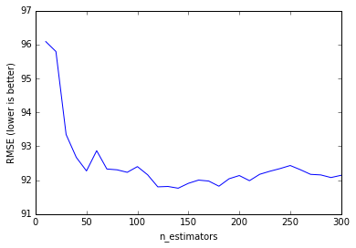
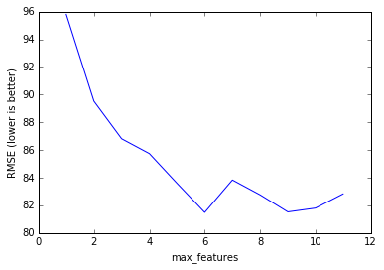
Optimizing Features:
Random Forest Regressor
Estimator Tuning
Feature Tuning
140
6
RMSE total : 91.88
RMSE optimized : 82.65
Optimized demographics: Life expectancy, adolescent BR, education, cell subscriptions, birth attendant, GNI
Notes:
for all demographics (CV=5, estimators=140)
for optimized features (CV=10, estimartors=130):

Slide 7
Model Comparisons
Selection of demographics: 'ABR%', 'AOD_FMLE', 'GNI', 'EDFMLE_MLE%', 'cell_Subscription%', 'attend%'.
All of the models improve null accuracy.
The random forest classifier performs better than the logistic regression model.
Reducing the number of demographics improves model accuracy.
The random forest regressor model is the only model run that produces MMR predictions.

Slide 8
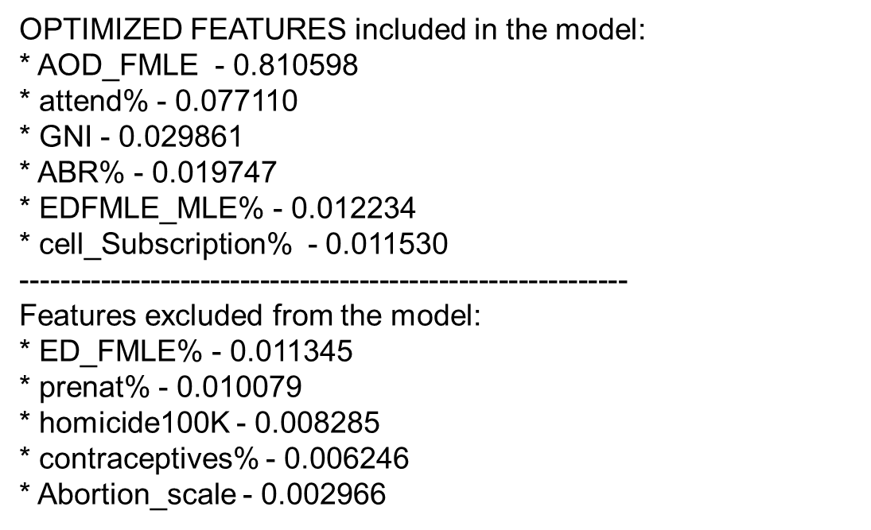
Conclusions
Demographic contributions to model:
Successful hypothesis: Education
Surprising outcomes: Abortion policy, cell phone subscriptions
Future Work
Build a model that lacks well known causal demographics and determine the predictability.
Add more demographics from the WHO website.
Notes:
Although the social burdens alone make this an important public health issue, there is also a steep economic cost HL in the form of disability, loss of days worked and the cost of devices to improve hearing. To better understand the progression of AHL I am going to describe mammalian auditory transduction

